Slide 1
An Overview of HARNET Hong Kong Academic & Research Network
David Choi
Chairman of NTF - JUCC
Notes:
1
1

Slide 2
HARNET
Established in 1985; connect to Internet in 1991
The wide area network which links up the campus networks of the 8 tertiary institutions in Hong Kong.
HARNET also provides network connectivity to its affiliate members and network members
Gateway for connecting to overseas Academic and Research networks
Funded, Planed, Managed and Operated by Joint Universities Computer Centre (JUCC)

Slide 4
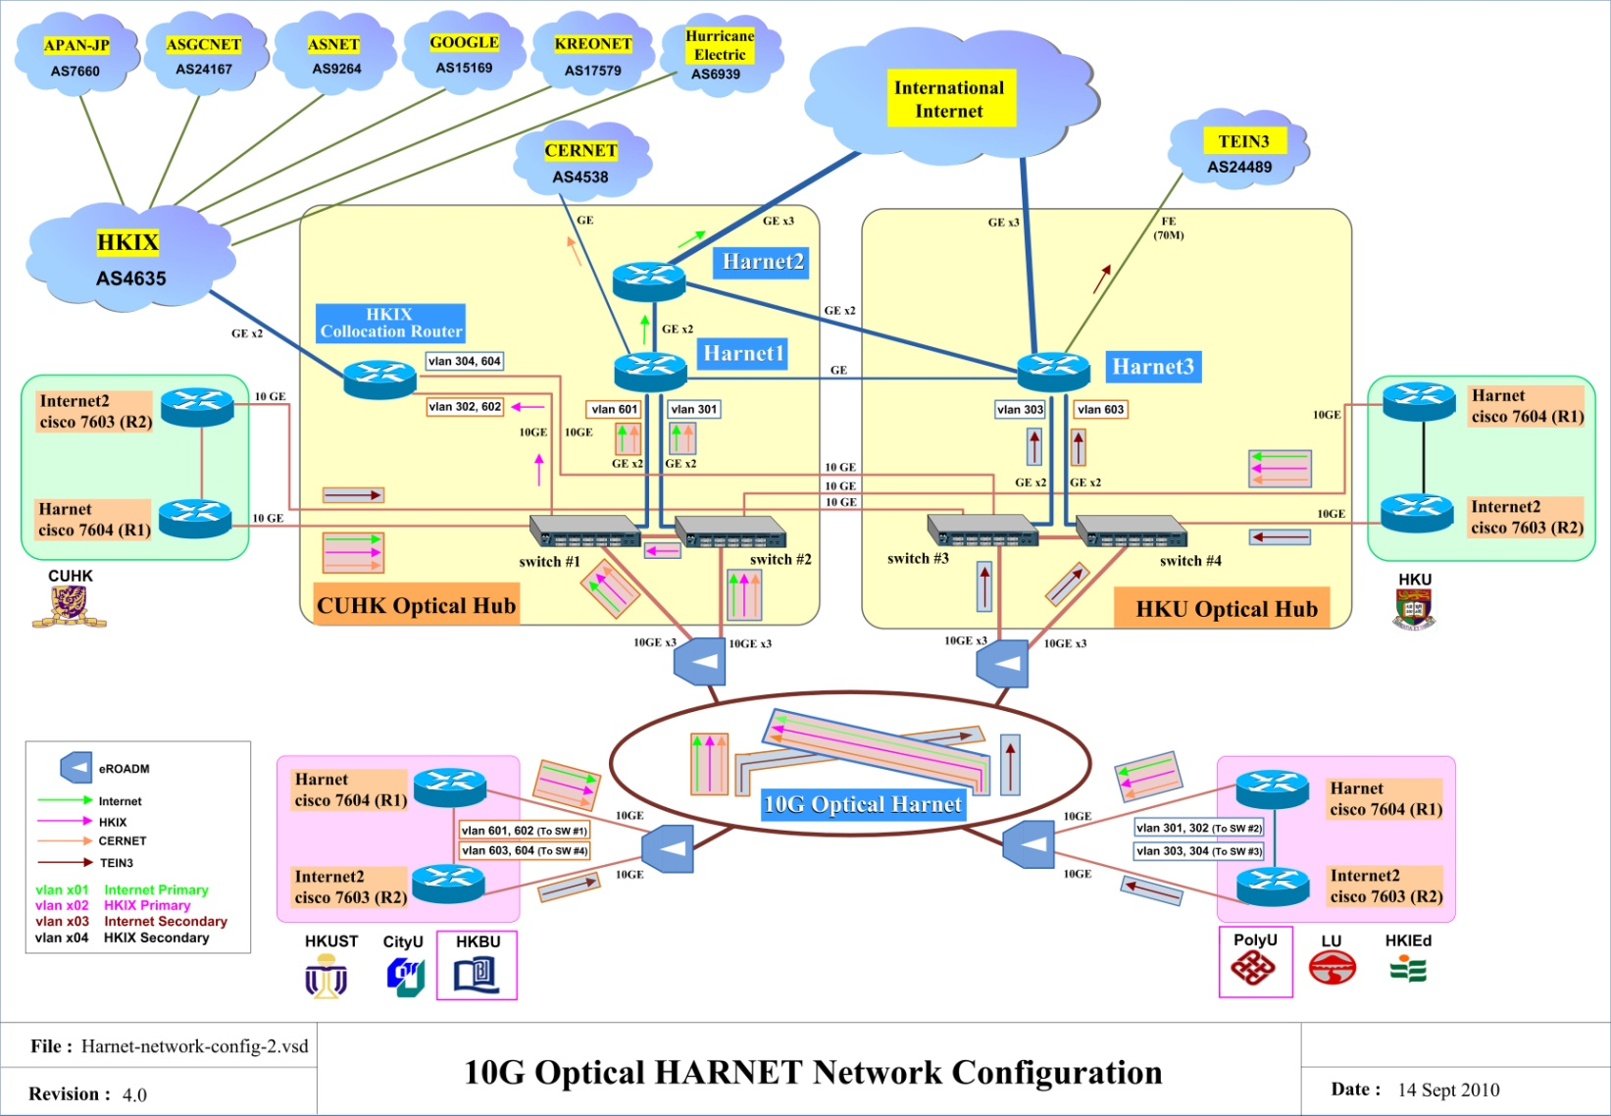
HARNET as of Today

Slide 5
Optical HARNET
10G Optical HARNET backbone connecting 8 member institutions
HKU and CUHK serve as Hub Data Centers
Each institution with 2x10G connecting to layer-2 10GE switches at the 2 Hub Sites
5x10G & 3xGE between the 2 Hub Sites

Slide 6
Optical HARNET
Based on ADVA multi-degree ROADM optical technology, up to 40 Lambdas (only used 17)
Multi-ring topology to allow high fault tolerance and high flexibility for connecting new nodes and incremental upgrades
Point to Point 10G any-to-any is possible
Unfortunately it is a managed (not owned) DWDM services
3-year managed wavelength service contract

Slide 7
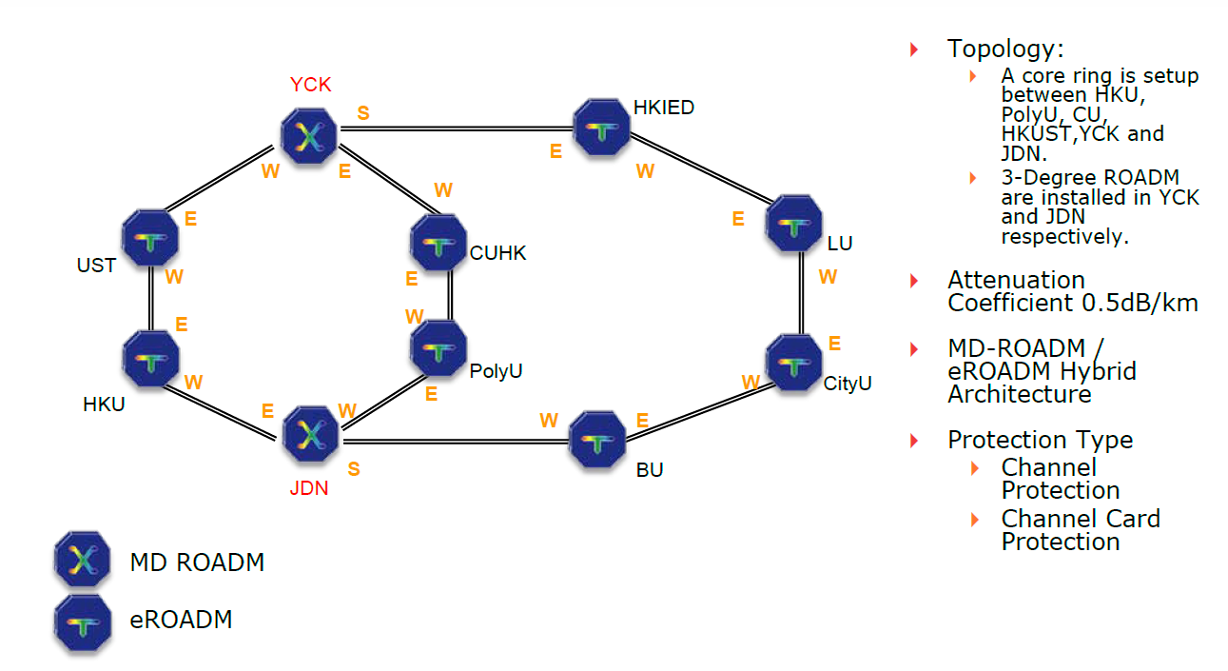
Optical HARNET

Slide 8
HARNET/Internet Connections
2 Gbps link to an ISP for International/Commodity Internet
2 Gbps link to HKIX for Local Internet
Collocation connections to NRENs:
155 Mbps link to CERNET
90 Mbps link to TEIN3
Private Peering via HKIX
Hurricane Electric, APAN-JP, ASGCNet, KREONET
ASNET, TANET, Google

Slide 9
Commodity Internet Connection
Bandwidth Subscription till 08 March 2012
Currently at 2Gbps;
Minimum Average at 1.75Gbps (1.2Gbps during last summer break)
Two circuits - Primary at CUHK and Secondary at HKU
100% redundancy; different submarine cables;
Bandwidth after 09 March 2012
Dual Stacks; Full Route
IPv4 – 2Gbps to 4Gbps; IPv6 – 300Mbps to 1Gbps
QoS – 95%

Slide 10
HARNET Internet B/W Growth since Year 2000

Slide 11
Collaboration over HARNET
Video Network Services
Riding on Optical HARNET
HD video-conferencing through a Polycom RMX 2000 HD MCU
Joint Webcasting of Lectures, Seminars through a Central web-casting facilities
On-demand video archives

Slide 12
Collaboration over HARNET
25Mbps
HD Camera
VLC Server
HD MPEG2 encoder
25Mbps
25Mbps
LCD TV
LCD TV

Slide 13
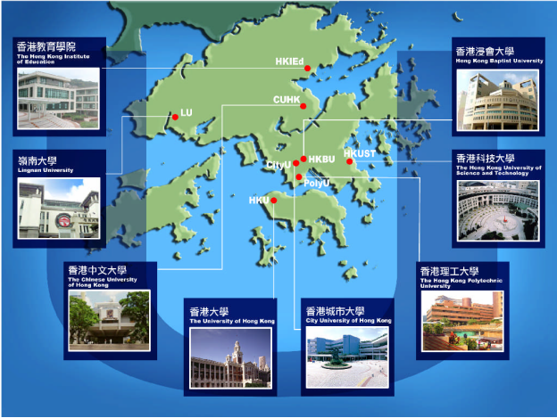
Collaboration over HARNET – Universities Wi-Fi

Slide 14
Collaboration over HARNET – Universities Wi-Fi
Enables inter-operable and fast mobile network communication among all JUCC institutions
Common authentication framework using industry standard IEEE 802.1x and radius authentication to support Wi-Fi roaming of the different brands of Wi-Fi access points across member institutions
SSID: “Universities WiFi”.
Project cost: HK$7.49 million
Launched in September 2009

Slide 15
Future Collaborations / Projects
IPv6
Library & Medical Applications
Telepresence
Disaster & Recovery via Optical HARNET
Cloud Services
HPC
Shared e-learning
ERP
SAN etc.

Slide 16
Thank You

Slide 17
What is JUCC ?
A consortium of Computing and IT Services Centres of all the Government-Funded Universities in Hong Kong
Founded in 1970, initially for
Operating the scarce and shared computer resources
Supporting the member institutions on computation needs
Has established to be an IT lead organization
Fostering deep collaborations among higher education institutions in Hong Kong
Providing up-to-date IT facilities and support services for academic and research excellence
Notes:
17
17

Slide 18
JUCC Members
8 full members, funded by University Grants Committee (UGC)
The University of Hong Kong (www.hku.hk)
The Chinese University of Hong Kong (www.cuhk.edu.hk )
The Hong Kong Polytechnic University (www.polyu.edu.hk)
City University of Hong Kong (www.cityu.edu.hk )
Hong Kong Baptist University (www.hkbu.edu.hk)
The Hong Kong University of Science and Technology (www.ust.hk)
Lingnan University (www.ln.edu.hk )
The Hong Kong Institute of Education (www.ied.edu.hk)
Notes:
18
18

Slide 19
JUCC Members
3 affiliate members
The Open University of Hong Kong (www.ouhk.edu.hk)
Vocational Training Council (www.vtc.edu.hk)
University of Macau (www.umac.mo)
2 network members
Hong Kong Examinations and Assessment Authority (www.hkeaa.edu.hk)
Hong Kong Science & Technology Parks (www.hkstp.org)
Notes:
19
19

Slide 20
Working Groups
Task Forces
Network Task Force
Information Security Task Force
Ad-hoc groups on special projects (e.g. Wi-Fi Technical Group, Anti-virus Software Evaluation Group)
Special Interest Groups
SIG on User Services

Slide 21
Current Services and Activities
Network service
Software licensing Co-ordination
Joint tendering and purchasing
Training and conferences
Joint collaboration projects
Wi-Fi collaborations
Information Security Taskforce
Offsite workshops with leading Mainland universities and Asia Pacific universities / organizations

Slide 22
Additional Information
Current JUCC Officers:
Board Chairman: Being nominated
Director of JUCC: Mr Gerrit Bahlman, Director of IT, PolyU
& Chairman of (Since Jul 2010, for a term of 2 years)
Steering Committee
NTF Chairman: Mr David Choi, Senior Computer Officer, CUHK
ISTF Chairman: Mr Gerrit Bahlman, Director of IT, PolyU

Slide 23
Missions of JUCC
To CONTRIBUTE our expertise to the development and application of IT in Hong Kong’s education community
To SUPPORT teachers, students, researchers and administrators in their pursuit of academic and research excellence
To SERVE academia in the nearby regions
Notes:
23

Slide 24
Visions of JUCC
To DEVELOP a high-speed education network to support all Universities and Schools in Hong Kong
To DEVELOP Hong Kong into an Internet Hub to support leading-edge research in the region
Notes:
24

